Slide 1
Demographic Cofactor Analysis of Opioid Use
Drew Gobbi, Olivia Wang, Maddie Warndorf
FP1

Slide 2
Why this Analysis Matters
Misuse of prescribed and illicit opioids is an epidemic in the United States that claims an average of 130 lives per day. In 2017 alone, more than 70,000 people died from a drug overdose, with almost 50,000 involving an opioid.
Public health professionals have been struggling with how to measure Opioid use effectively, since it is not directly observable. The opioid use proxies we focus on are opioid-related EMS calls (e.g. overdoses) and wastewater estimated number of opioid users/1000.
Determining if certain community factors are strongly correlated with opioid use can help public health professionals identify vulnerable populations and/or develop more effective interventions for treatment.
Notes:
OLIVA

Slide 3
Potential Hypotheses
This study uses geospatial and temporal data to test the association between community level demographic features and various types of healthcare facilities and opioid use.
The relationship between cofactors is likely to vary based on the type of opioid under study. We rely on common health narratives and past research to form the following hypotheses:
Indicators of low economic status (such as median household income or the percent of individuals below poverty in an area) may be positively associated with heroin use.
Wealthy, young professionals or middle-aged advantaged populations who have previously been legally prescribed Oxycodone could later move on to misusing the drug.
Indicators of gentrification, neighborhood change, and economic inequality may lead to drug use.
Certain health care facilities such as substance abuse facilities may have a positive association with opioid indicators, while others like pharmacies (where drug drop offs are located and prescriptions are necessary for pickup) may be negatively associated.
Notes:
OLIVIA

Slide 4
Proxies for Opioid Use and Units of Analysis

Slide 5
Opioid-Related EMS Calls
Measuring opioid use as the count of emergency service (EMS) calls in a given Census block group and year-month in the sample for both Cincinnati and Tempe.
EMS calls are available as point data. Each point that falls in a block group is totalled up for that block group and then the block group totals are segmented by year-month.
Ex. of typical unit: 3 EMS calls in September 2017 in Cincinnati block group 13.
5,912 EMS calls available in Cincinnati
284 block groups X 38 year-months in sample = 10,792 possible observations
7,174 when dropping block-group/year-month pairs where there is no covariate data
EMS calls are only heroin related
675 EMS calls available in Tempe
109 block groups X 33 year-months in sample = 3,597 possible observations
2,508 when dropping block-group/year-month pairs where there is no covariate data
EMS calls are all opioid-related cases
Notes:
DREW

Slide 6
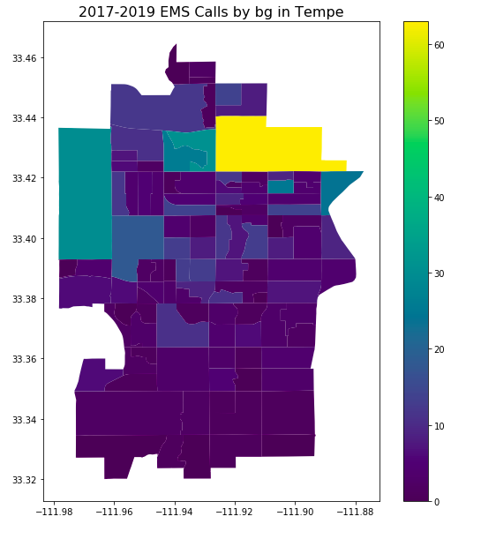
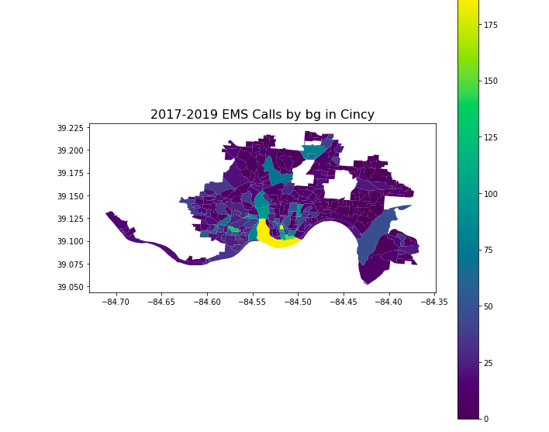
EMS Call Heat Maps for Cincinnati (L) and Tempe (R)
Notes:
Graphic Edit

Slide 7
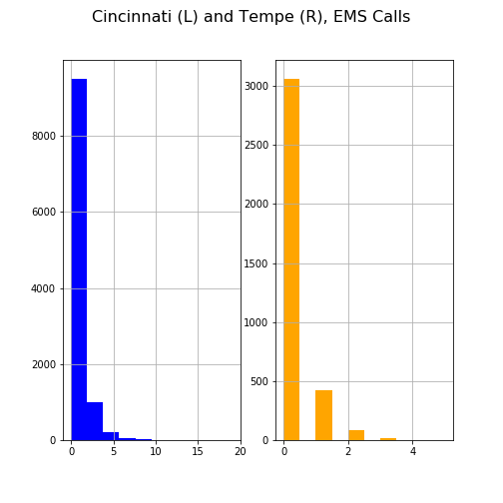
EMS Calls in Year-Month/Block-Group Pairs Appear Poisson Distributed
Notes:
Graphic edit

Slide 8
Controlling for Temporal Variation in Opioid Related EMS Calls
It’s reasonably likely that the data could follow a time series process and that an observation in a given location in current year month can be a function of the past values in that same location.
We test for stationarity using an augmented dicky fuller (ADF) test for the EMS calls in each block group
In Cincinnati 39/284 block groups are non-stationary. 14% of EMS calls occur in non-stationary block groups.
In Tempe 24/109 block groups are non-stationary. 30% of total EMS calls occur in non-stationary BGs.
Non-stationary block groups are assessed in separate regression models from the stationary ones. Regressions occur on the monthly differences, rather than level terms.
Differenced series generally pass the ADF test, and examinations of the autocorrelation functions partial autocorrelation functions of non-stationary block groups suggest that adding additional autoregressive or moving average terms is unnecessary.
Notes:
DREW

Slide 9
Wastewater Estimates of Opioid Users in Tempe
Tempe city government and Arizona State University (ASU) have been testing the city’s wastewater for the population normalized mass load (PNML) of opioids.
PNML gives a baseline estimate of mg/day/1,000 individuals in an area.
Dividing the estimate by the average opioid dose expected of a user in mg/day gives the wastewater estimated number of users per 1,000.
We test the same covariates used in the EMS call model on these estimates.
Wastewater estimates are available for Heroin, Oxycodone, Fentanyl, and Codeine.
Notes:
Maddie

Slide 10
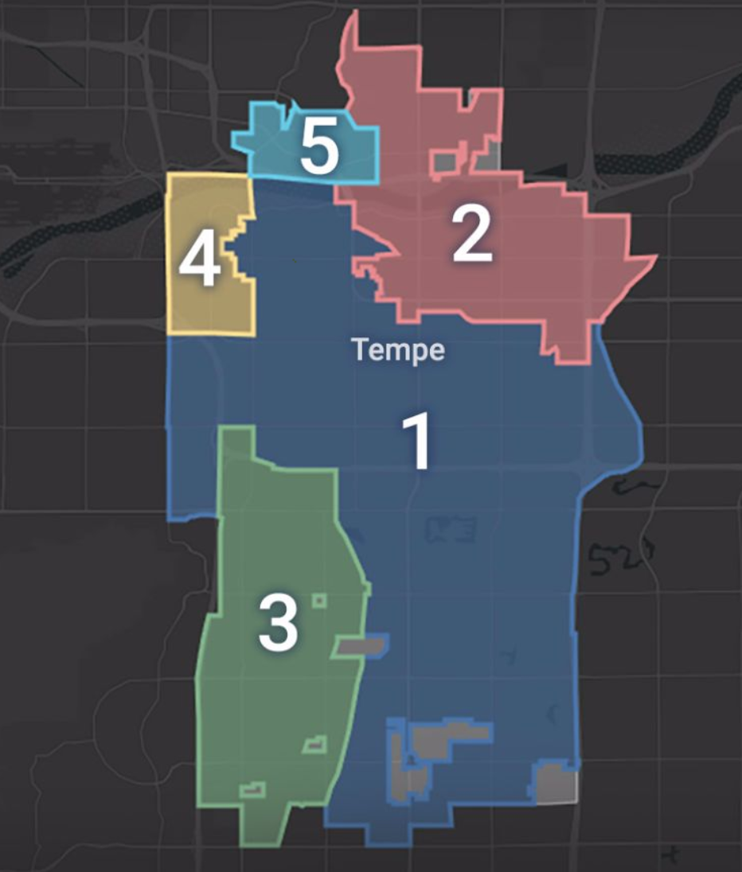
Wastewater Units of Analysis
Spatial unit changes to the five collection sites where wastewater data is collected.
We use the average of the demographic covariates for all of the block groups contained within each site collection area.
Wastewater estimates are still aggregated by the number of users per year-month per site collection area.
16 year-months in the wastewater sample X 5 site collections = 80 possible observations per drug. Some as low as 64 observations depending on when data started collection.
We consider all negative values in the dataset to be measurement errors and drop them.
https://tempegov.maps.arcgis.com/apps/Cascade/index.html?appid=92073d7f6a6a498b987f2afdab1b9471
Notes:
Maddie

Slide 11
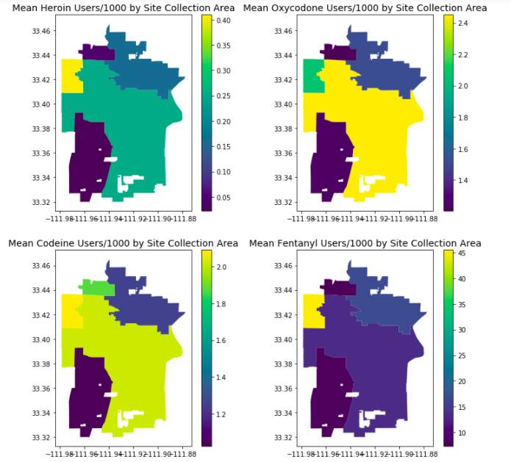
Heat Map of the Average Number of Wastewater Estimated Users in Tempe (1 of 2)
Notes:
Maddie

Slide 12
Heat Map of the Average Number of Wastewater Estimated Users in Tempe (2 of 2)
Notes:
Maddie

Slide 13
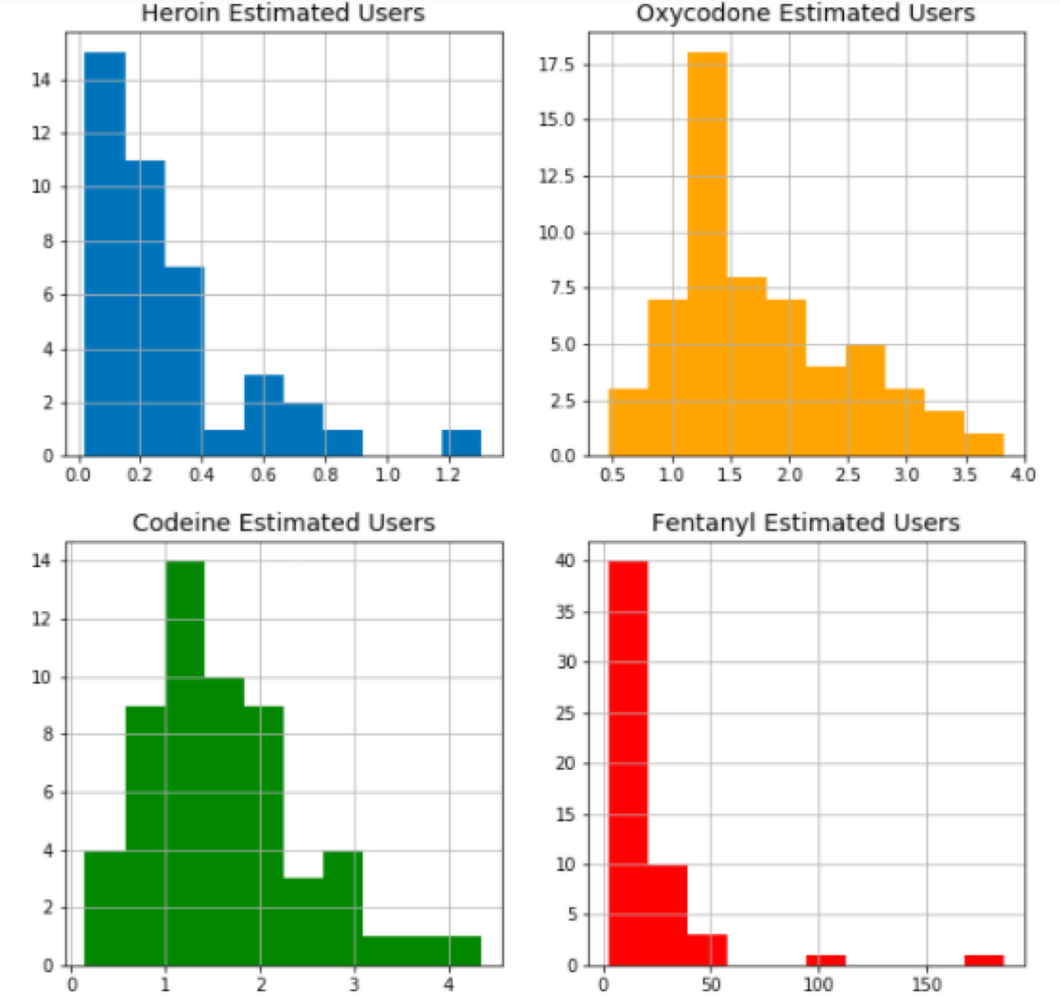
Wastewater Data Estimates for Each Drug is Right Skewed
Notes:
Maddie

Slide 14
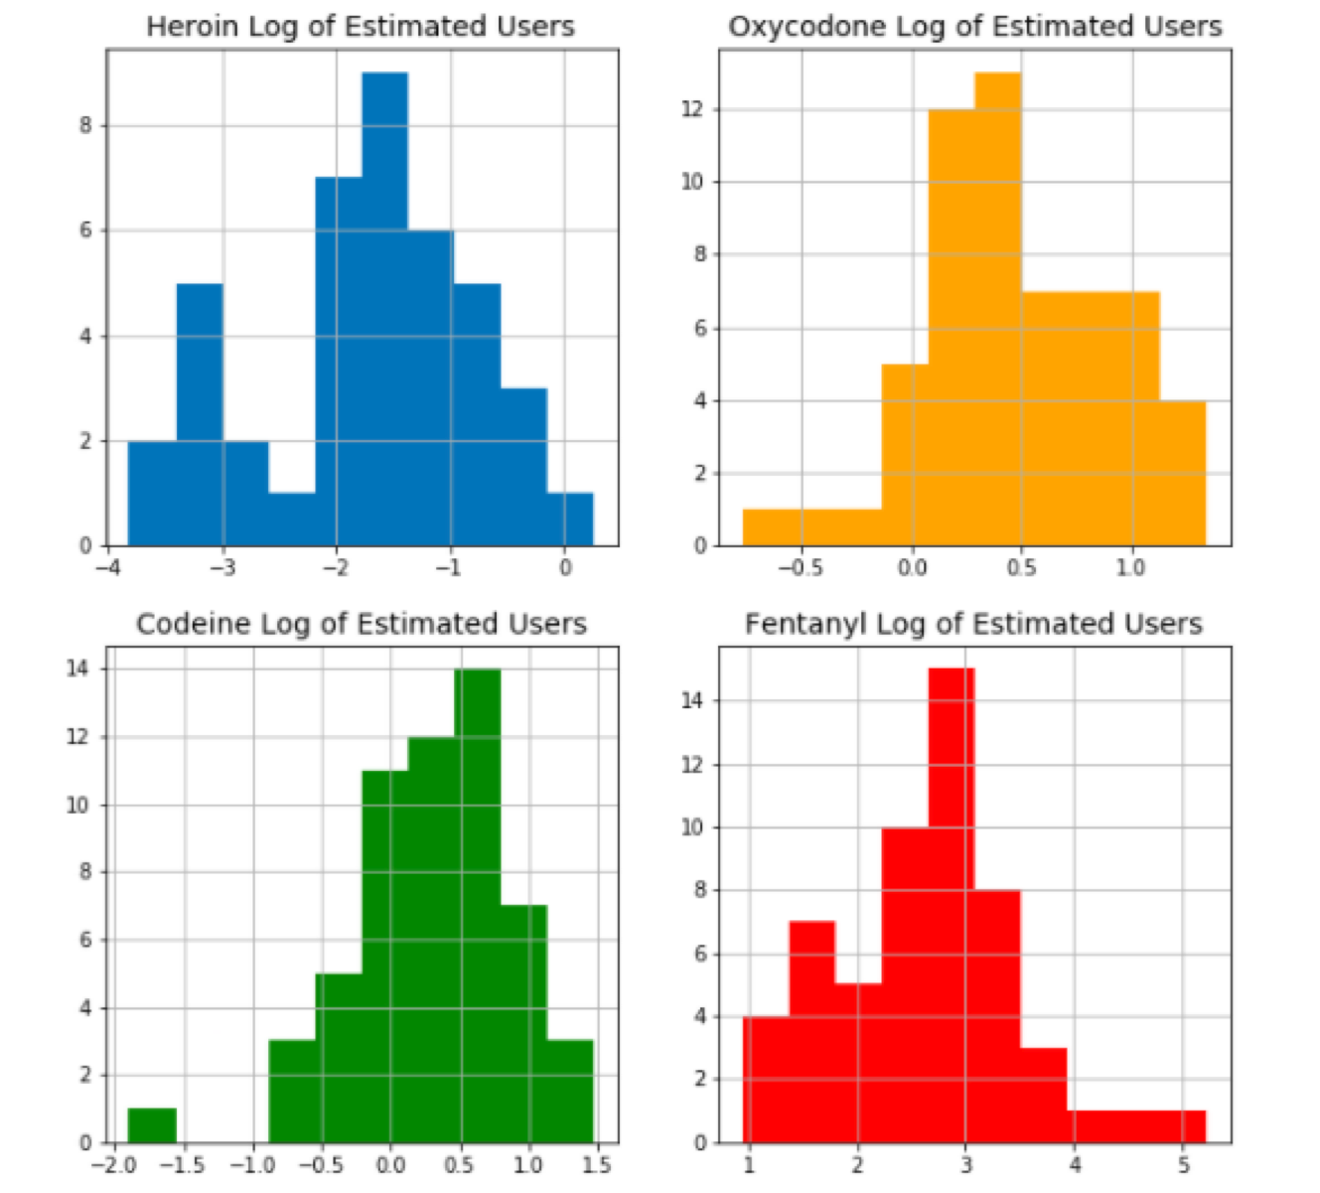
We Assume that the Data are Log-Normal, Which is a Strong Assumption
Taking the log of each value does not make each series look perfectly gaussian.
Assume by law of large numbers that as our low sample size (<80 observations) increases it will tend towards a normal shape.
Allows us to use OLS estimators.
Notes:
OLIVIA

Slide 15
Controlling for Temporal Variation in Wastewater Estimates of Opioid Calls
We use the same testing procedure for stationarity among the four wastewater estimates of opioid users for each of the four drugs we have data for.
3 of 5 site collections fail the ADF tests in the level series.
A closer look at the autocorrelation functions and partial autocorrelation functions of the level series that failed the ADF test do not show lags statistically significantly different than zero beyond seemingly random spikes in significance (e.g. month 7 of 16 in the sample in one drug, shows a statistically significant autocorrelation).
We make the assumption that these significant autocorrelations are random spikes that are throwing off the relatively short time series. As such, we continue to use the level values in our regression estimates, which could bias results.
Notes:
DREW

Slide 16
Independent Variables

Slide 17
Demographic Covariates
Leverage the same arbitrary list of covariates as those identified by Li et. al in “Suspected heroin-related overdoses in Cincinnati, Ohio: A spatiotemporal analysis,” a similar study of EMS calls in Cincinnati.
Extract five year American Community Survey (ACS) estimates from the 2019 Census Planning Database File (representing 2013-2017).
Demographic covariates only vary over space. They do not vary over time.
Also test the effects of the change in these covariates to measure the potential impact of gentrification in block groups on opioid usage. Calculate the change by subtracting the latest non-overlapping five-year estimates from the 2019 data (e.g. 2013-2017 estimates - 2009-2012 estimates).
Notes:
OLIVIA

Slide 18
Demographic Covariates Included In the Study
Proportion of males
Proportion of 18-24 aged individuals
Proportion of 25-44 aged individuals
Proportion of 45-64 aged individuals
Proportion of 65 years or older individuals
Proportion of individuals below poverty
Median home value
Proportion of individuals with a college degree or higher
Natural logarithm of the total population in the spatial unit
Proportion of Hispanic individuals
Proportion of households where all individuals are white alone
Proportion of households where all individuals are black alone
Proportion of households where all individuals are Asian alone
Median household income (Median HHI)
Notes:
OLIVIA

Slide 19
Facilities Covariates
The facility data was gathered from the following cites:
Tempe: Arizona Department of Health Services’ ArcGIS Service Directory (AZLicensedFacilities and DrugDropOffLocations feature layers), Arizona State Board of Pharmacy’s data provided through Arizona Department of Health Services’ ArcGIS Service Directory, Naloxone ArcGIS Feature Layer.
Cincinnati/Kentucky: Ohio Public Health Information Warehouse provided the health facilities and pharmacies, Pharmacy Ohio list of licensed naloxone distributors, J. Lindemann’s National Prescription Drop Box ArcGIS layer, and T. Peacock’s Walgreen’s Drug Kiosk Locations ArcGIS layer.
The facilities analyzed include:
Medical-Based Facilities: Hospitals (psychiatric, general, and children’s), mental facilities, hospice, nursing homes (excluding home health agencies (HHA), adult foster care centers, and adult day health care centers), pain management, physical therapy, substance abuse centers, surgical centers, urgent care, child facilities, women’s health facilities, and generic medical facilities (excluding radiology, dialysis, sleep centers, imaging, and renal).
Community Drug-Related Facilities: Pharmacies, drug drop-off centers, and naloxone distribution facilities.
Facilities were counted within a 2 mile radius of the centroid for each census block group and wastewater collection site.
Notes:
MADDIE The relationship between covariates and opioid usage varies across region, but here are the facilities that covary with opioid use
Pain management facility
Substance abuse facility
Pharmacy
Naloxone distribution
Nursing home
Physical therapy
Mental facility
...

Slide 20
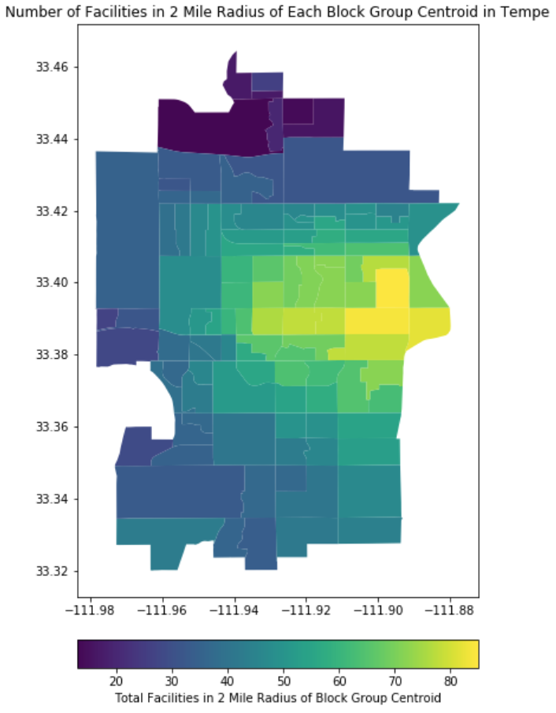
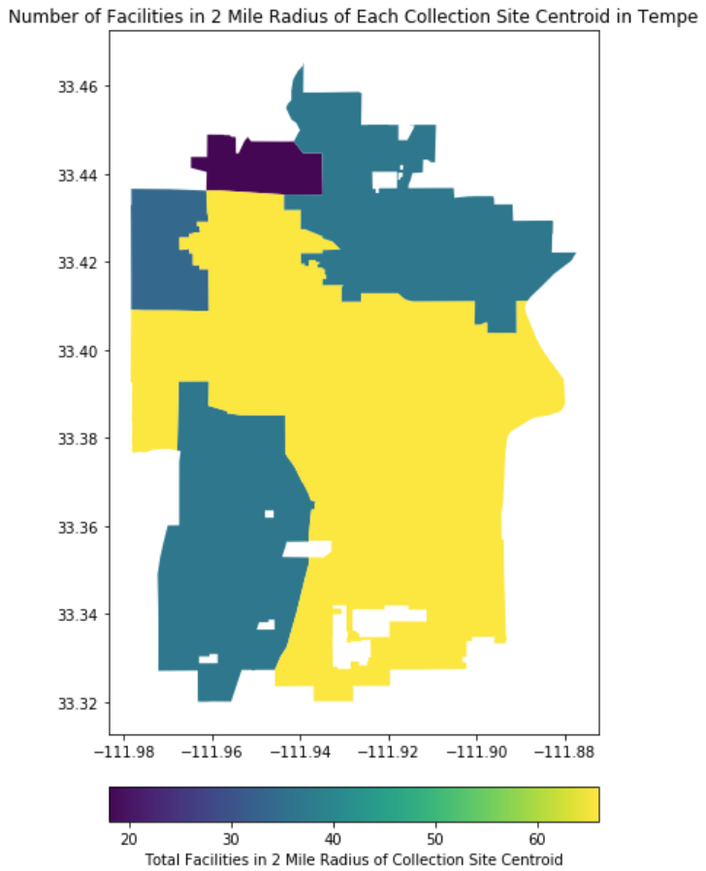
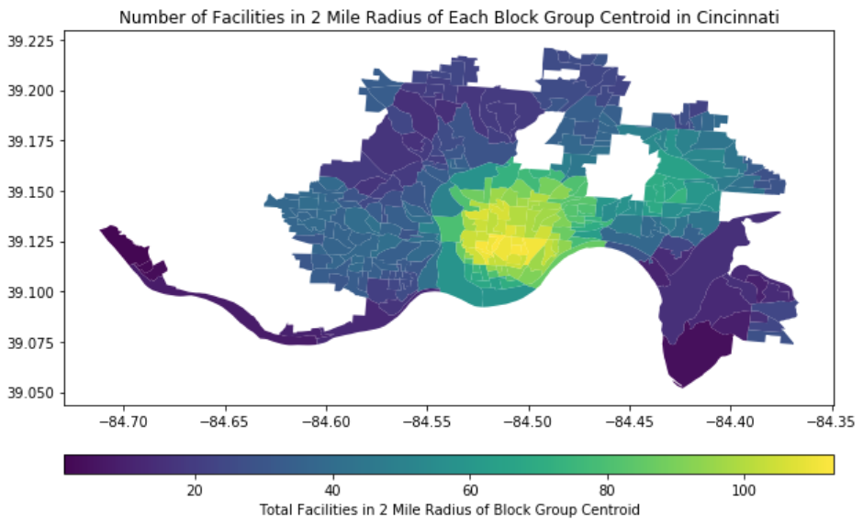
Heat Maps for Number of Facilities in Each Spatial Unit

Slide 21
Analysis of EMS Call Data

Slide 22
EMS Calls Experimental Design
Employ three different experiments in each city.
First, use logistic regression to classify observations that are zero or non-zero to determine which factors may lead to an EMS call
In Cincinnati, zero class = 7,453 observations, non-zero class = 3,339
In Tempe, zero class = 3,063 observations, non-zero class = 534
Second, utilize poisson regression of the same cofactors on the non-zero observations in both cities.
Finally, utilize a poisson regression for all differenced EMS call observations in the non-stationary block groups
Note: regression does not converge with all covariates included, so split into two sub analyses of covariates. A) effect of demographics on EMS calls and B) effects of facilities counts on EMS calls
Cofactors that are statistically significant across all experiments in each city are more likely to exhibit a meaningful relationship with the EMS calls.
Cofactors that are statistically significant across all experiments in both cities could be generalizable.
Notes:
DREW

Slide 23
Review of Comparison of all EMS Specifications
 | Cincinnati EMS Logit | Cincinnati EMS Non-Zero | Cincinnati EMS in Differences Non-Stationary Bgs | Tempe EMS Logit | Tempe EMS Non-Zero | Tempe EMS Non-Stationary Bgs
Positive Cofactors | %25-44, %Asian Alone, %Below Poverty, Log Pop, Women's Clinics, Pain Management, Substance Abuse, Other Medical Facilities, Pharmacies | %Below Poverty, Log Pop, Pain Management, Substance Abuse, Naloxone Distribution | %Male, Pain Management, Other Medical Facilities | %Males, %Hispanic, %College, Psych Hospitals, Child Facilities, Drug Drops | N/A | %Male, %Hispanic, %Asian, %Below Poverty, %College, Hospitals, Urgent Care, Physical Therapy, Nursing Homes, Drug Drops, Naloxone
Negative Cofactors | %18-24, %White Alone, %Black Alone, %College, Urgent Care, Physical Therapy, Nursing Homes, Children’s Hospitals | %White Alone, %Black Alone, %College, Physical Therapy, Nursing Homes, Children’s Hospitals, Pharmacies | %25-44, %45-64, %Asian, Med HHI, %Below Poverty, Pharmacies | %18-24, %25-44, %65+, Median House Value, Surgical Centers, Urgent Care, Pain Management, Mental Facilities | N/A | %25-44, %Black Alone, Med HHI, Log Pop, Substance Abuse, Pharmacies
Note: Only statistically significant cofactors at 5% level included in the table above
Notes:
DREW
Heroin use appears to increase with population density and the rate of poverty
Heroin use decreases as the percentage of households where all members are black or white increases. Taken with finding #1, we think a possible explanation for this could be that opioid use may be more likely in urban centers with diverse populations and economic inequality
Pain management and substance abuse facilities are positively correlated with opioid use → this makes sense intuitively, as these areas would be among the first to call an ambulance in the event of an overdose
Opioid related EMS calls tend to decrease around nursing homes and children’s hospitals. → These locations are where we would not expect heroin use to take place, and so logically expect to see low correlations
TEMPE
Hispanic and male individuals are associated with opioid EMS calls in Tempe, reflecting the city’s different demographics compared to Cincinnati
Substantial amount of noise in the results does not yield clear conclusions for EMS calls → We think that this could be due to the fact that the city does not make a distinction between type of opioid used

Slide 24
Logistic Regression - Key Covariates
 | Cincinnati | Tempe
Positive Cofactors | %25-44, %Asian Alone, %Below Poverty, Log Pop, Women's Clinics, Pain Management, Substance Abuse, Other Facilities, Pharmacies | %Males, %Hispanic, %College, Psych hospitals, Child Facilities, Drug Drops
Negative Cofactors | %18-24, %White Alone, %Black Alone, %College, Urgent Care, Physical Therapy, Nursing Homes, Children’s Hospitals | %18-24, %25-44, %65+, Median House Value, Surgical Centers, Urgent Care, Pain Management, Mental Facilities
Note: Only statistically significant cofactors at 5% level included in the table above

Slide 25
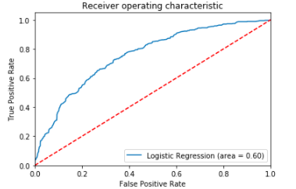
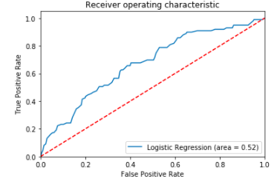
Logistic Regression Results
Cincinnati
Tempe

Slide 26
Poisson Regression of Non-Zero Observations in Stationary Block Groups
 | Cincinnati | Tempe
Positive Cofactors | %Below Poverty, Log Pop, Pain Management, Substance Abuse, Naloxone Distribution | N/A
Negative Cofactors | %White Alone, %Black Alone, %College, Physical Therapy, Nursing Homes, Children’s Hospitals, Pharmacies | N/A
Note: Only statistically significant cofactors at 5% level included in the table above

Slide 27
Poisson Regression on EMS Call Differences in Non-Stationary Block Groups
 | Cincinnati | Tempe
Positive Cofactor | %Male, Pain Management, Other Medical | %Male, %Hispanic, Asian, %Below Poverty, %College, Hospitals, Urgent Care, Physical Therapy, Nursing Homes, Drug Drops, Naloxone
Negative Cofactor | %25-44, %45-64, %Asian, Med HHI, %Below Poverty, Pharmacies | %25-44, %Black Alone, Med HHI, Log Pop, Substance Abuse, Pharmacies
Note: Only statistically significant cofactors at 5% level included in the table above

Slide 28
In Review: Comparison of all EMS Specifications
 | Cincinnati EMS Logit | Cincinnati EMS Non-Zero | Cincinnati EMS in Differences Non-Stationary Bgs | Tempe EMS Logit | Tempe EMS Non-Zero | Tempe EMS Differences in Non-Stationary Bgs
Positive Cofactors | %25-44, %Asian Alone, %Below Poverty, Log Pop, Women's Clinics, Pain Management, Substance Abuse, Other Medical Facilities, Pharmacies | %Below Poverty, Log Pop, Pain Management, Substance Abuse, Naloxone Distribution | %Male, Pain Management, Other Medical Facilities | %Males, %Hispanic, %College, Psych Hospitals, Child Facilities, Drug Drops | N/A | %Male, %Hispanic, %Asian, %Below Poverty, %College, Hospitals, Urgent Care, Physical Therapy, Nursing Homes, Drug Drops, Naloxone
Negative Cofactors | %18-24, %White Alone, %Black Alone, %College, Urgent Care, Physical Therapy, Nursing Homes, Children’s Hospitals | %White Alone, %Black Alone, %College, Physical Therapy, Nursing Homes, Children’s Hospitals, Pharmacies | %25-44, %45-64, %Asian, Med HHI, %Below Poverty, Pharmacies | %18-24, %25-44, %65+, Median House Value, Surgical Centers, Urgent Care, Pain Management, Mental Facilities | N/A | %25-44, %Black Alone, Med HHI, Log Pop, Substance Abuse, Pharmacies
Note: Only statistically significant cofactors at 5% level included in the table above

Slide 29
Analysis of Tempe PNML Data

Slide 30
Wastwater Experimental Design
As described previously, we are making some strong assumptions about the data structure in our analysis of the waste water estimates of opioid users
Assuming that the data would tend towards a log-normal distribution if more observations were available.
Assuming that the data is still weakly stationary and the failed ADF tests are due to random or measurement errors in the data.
Means we are assuming the data are identically and independently distributed, even though there is reason to believe that they may not be.
Use OLS regression of our demographic and facilities covariates on the level values for each drug we have data for in Tempe: Heroin, Oxycodone, Codeine and Fentanyl.
Notes:
MADDIE

Slide 31
Wastewater Regression Results
 | Heroin | Oxycodone | Codeine | Fentanyl
Positive Cofactor | %Hispanic, Psych Hospitals, Mental Facilities, Other Medical Facilities, Nursing Homes, Drug Drop | %45-64, %65+, %White Alone, Other Medical Facilities, Nursing Homes, Pharmacies | %45-64, Mental Facilities, Nursing Homes, Pharmacies | %Male, %25-44, %Hispanic, Mental Facilities, Other Medical Facilities, Pharmacies, Drug Drop
Negative Cofactor | %18-24, Median House Value, Hospitals, Urgent Care, Substance Abuse, Hospice, Child Facilities, Pharmacies | %18-24, %Below Poverty, EMS calls, Drug Drop | %18-24, Hospitals, Hospice, Child Facilities, Physical Therapy, Naloxone Distribution | %18-24, %Black Alone, Med HHI, Urgent Care, Substance Abuse, Nursing Homes, Hospice
Note: Only statistically significant cofactors at 10% level included in the table above
Notes:
MADDIE
Wastewater results vary substantially between drugs
Oxycodone and Codeine are both positively associated with older populations, nursing homes and pharmacies → This makes sense, as wastewater estimates also pickup legal drug use and these facilities/groups are likely to be legally prescribed
Hispanic individuals show a positive association with Heroin, while men tend show one with Fentanyl, suggesting that these groups may be different subgroups encompassed in the EMS results
Noise in the facilities results in wastewater models could be a result of the large size of the waste water site collection areas. Ex. It’s plausible that there is a spurrious correlation between Heroin use and nursing homes, because sites collection areas encompass multiple neighborhoods that may have very different underlying characteristics

Slide 32
Discussion and Conclusions

Slide 33
Relationships Uncovered:
Opioid (Heroin) EMS Calls in Cincinnati
Heroin use appears to increase with population density and the rate of poverty
Heroin use decreases as the percentage of households where all members are black or white increases. Taken with finding #1, we think a possible explanation for this could be that opioid use may be more likely in urban centers with diverse populations and economic inequality
Pain management and substance abuse facilities are positively correlated with opioid use → this makes sense intuitively, as these areas would be among the first to call an ambulance in the event of an overdose
Opioid related EMS calls tend to decrease around nursing homes and children’s hospitals. → These locations are where we would not expect heroin use to take place, and so logically expect to see low correlations
Notes:
MADDIE

Slide 34
Relationships Uncovered:
Opioid EMS Calls and Wastewater in Tempe
Hispanic and male individuals are associated with opioid EMS calls in Tempe, reflecting the city’s different demographics compared to Cincinnati
Substantial amount of noise in the results does not yield clear conclusions for EMS calls → We think that this could be due to the fact that the city does not make a distinction between type of opioid used
Wastewater results vary substantially between drugs
Oxycodone and Codeine are both positively associated with older populations, nursing homes and pharmacies → This makes sense, as wastewater estimates also pickup legal drug use and these facilities/groups are likely to be legally prescribed
Hispanic individuals show a positive association with Heroin, while men tend show one with Fentanyl, suggesting that these groups may be different subgroups encompassed in the EMS results
Noise in the facilities results in wastewater models could be a result of the large size of the waste water site collection areas. Ex. It’s plausible that there is a spurrious correlation between Heroin use and nursing homes, because sites collection areas encompass multiple neighborhoods that may have very different underlying characteristics
Notes:
MADDIE

Slide 35
Limitations and Future Considerations
Ecological fallacy in wastewater data → site collection areas encompass multiple block groups, and relationships at this level may not be representative of usage patterns in the smaller spatial units they contain
“User profiles” are different depending on the Opioid examined. EMS data that does not distinguish between type of drug may introduce significant amounts of noise and confounding relationships into the data
EMS typically reflect where a user overdosed or was arrested, which is often not where that individual lives. So, models that rely on households or neighborhood demographic data may not be as predictive compared to ones that consider other features of an environment (e.g. parking lots or vacant areas) where usage might occur
Wastewater data is limited, but demographic and household data may be a good predictor of this construct for opioid use because individuals are likely to eventually return home and “pass” the opioids
Notes:
DREW

Slide 36
Conclusions/Recommendations to Policy Makers and Data Analysts
Opioids and opioid users are not interchangeable - different substances have different user profiles and root causes, and will likely need different intervention strategies too
Localize the problem - Opioid use varies spatially and models benefit from accounting for this variation. Collecting data at small spatial units - such as the census tract or block group level - can help uncover which types of households and which neighborhood features may be correlated with opioid use and could benefit from potential interventions
Develop more proxies to measure opioid use - both EMS calls and wastewater estimates are flawed measures of opioid use that only tell part of the story. Models that consider additional and novel data sources to reflect potential opioid usage can help identify key risk factors and root causes by providing assurances of construct validity.
Notes:
DREW

Slide 37
Questions

